Slide 1
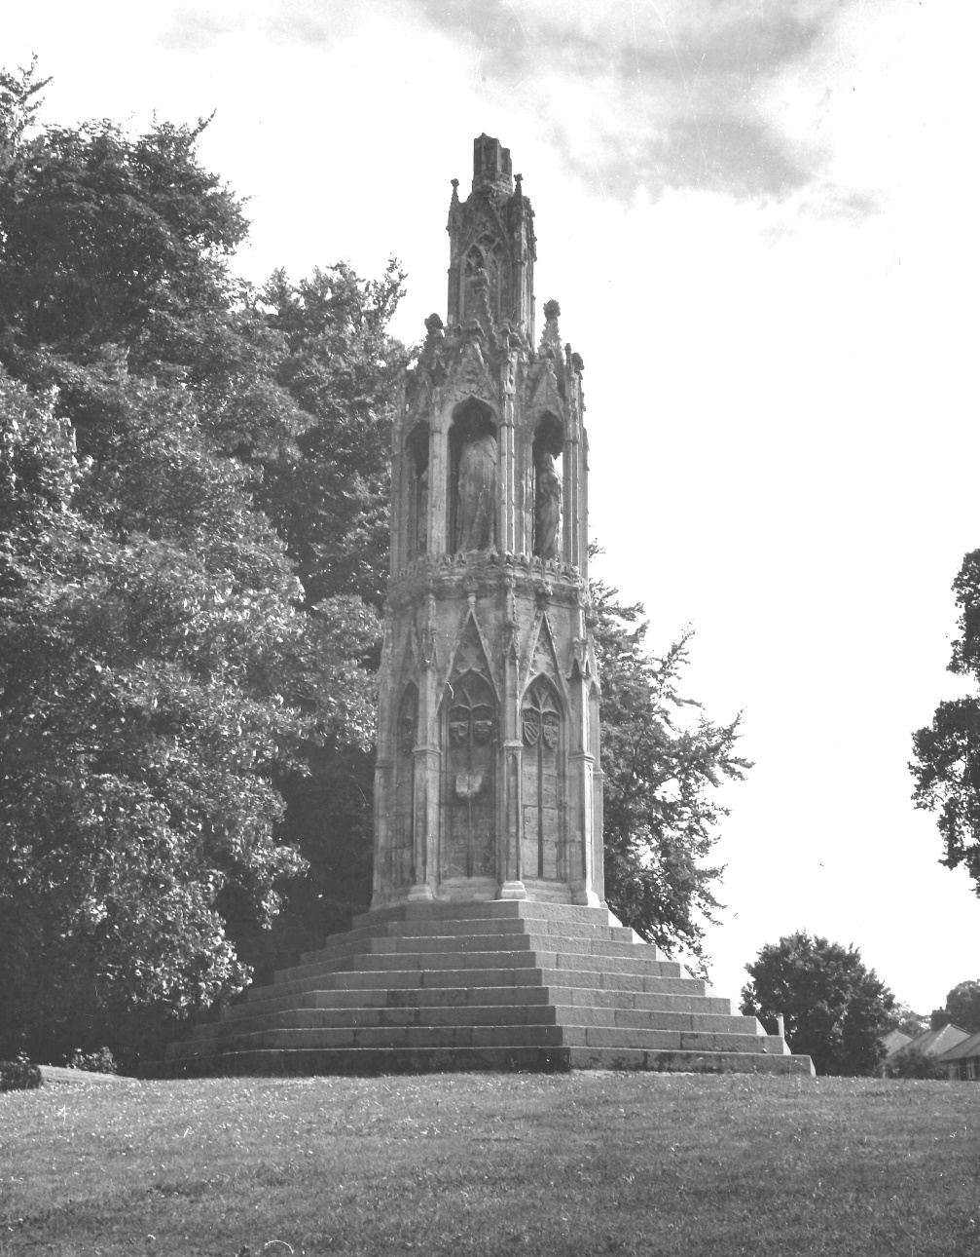

Queen Eleanor Cross
A Programme of Sensitive repair -
an overview

Slide 2

Queen Eleanor Cross
Statutory Protection
Scheduled Monument
Scheduled 25 January 1927
Grade I Listed Building
Included on the statutory list 9 December 1968

Slide 3
Queen Eleanor Cross
Scheduled Monument Consent – when is it required?
Consent is required for ‘ any works resulting in the demolition or destruction of or any damage to a scheduled monument,
Any works for the purpose of removing or repairing a scheduled monument or any part of it or of making any alterations or additions thereto,
Any flooding or tipping operations on land in, on or under which there is a scheduled monument
NOTE - SMC trumps the need to obtain Listed Building Consent

Slide 4
Queen Eleanor Cross
A partnership approach
Discussions held between Historic England and the Council regarding the best approach for the repair of the monument.
It was considered that a condition survey was required to inform what repairs were required and the approach to be taken for identified repairs.
Historic England proposed to add the Cross to the Heritage At Risk Register - included on the register in 2018.

Slide 5
Queen Eleanor Cross
Scheduled Monument Consent – the process
Application submitted on 28 April 2017
Consent Granted 14 June 2017
Variation to the consent granted 10 January 2018 to facilitate additional works identified during the course of the condition survey to be undertaken.

Slide 6

Queen Eleanor Cross
Establishing the condition
Council sought quotations for undertaking a condition survey of the structure from specialist companies.
Following a competitive tender process Cliveden Conservation were commissioned to undertake a survey and some essential remedial repairs.
Survey work commenced October 2017 with the final report submitted February 2018
+

Slide 7
Queen Eleanor Cross
Applying for Heritage at Risk Grant
An application was made to Historic England for grant funds towards the repair for the monument.
The application was made on 27 April 2018
Historic England made an offer of grant on 15 May 2018

Slide 8
Queen Eleanor Cross
Next Steps
It was considered that a specialist consultancy should be appointed to project manage the works identified in the Cliveden report and any other repairs which were identified as necessary and appropriate to be undertaken
Following a competitive tendering process, Acanthus Clews were commissioned in July 2018 to manage the project on the Council’s behalf. Lead for the project is Henry Sanders, a conservation accredited architect, who will now offer some details of the next stage of the project.

