Slide 1
Practical Conservation The actual works carried out to the Cross
Eleanor Cross Symposium
Abington Park Museum, Northampton
3rd October 2019
Dr David Carrington ACR FSA
Skillington Workshop Ltd

Slide 2
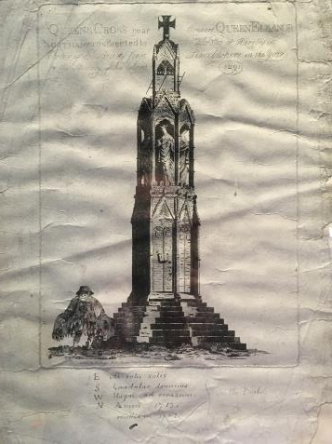
Timeline of previous interventions
c.1292 Construction.
1460 -The Battle of Northampton is fought close to the Cross, when it is described as being headless.
1713 -The Cross is restored by the Magistrates and Justices of the County of Northampton.

Slide 3
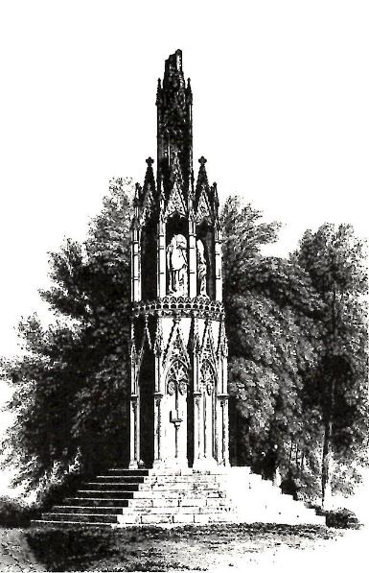
1762 - A further restoration.
1840 - Restoration carried out by architect Edward Blore working with historian George Baker.
1885 - Restoration with replacement of steps.
1848

Slide 4
1902 - ‘Dirt and stones’ removed, ‘small quantities’ of perished stone renewed, copper hold-fasts added to a statue.
1926 - Works carried out by Office of Works from central government.
1936 - Minor works being carried out.
c.1977 - A finial was re-made.
1984? - Major conservation programme.
2018 - Cliveden Conservation Condition Survey and Report.

Slide 5
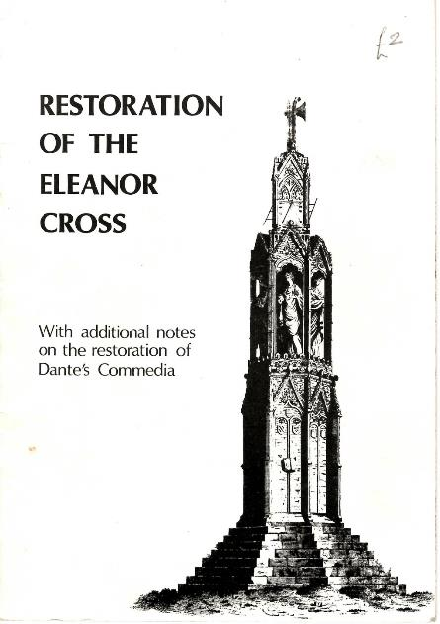
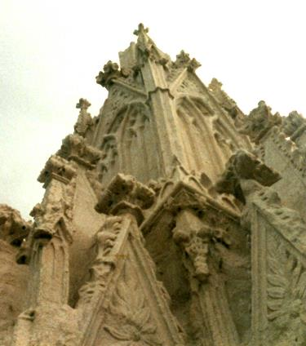
Photos taken at the time of the 1984 conservation programme by a visitor to the works, handed to us at an open day
Booklet published just after the 1984 restoration, believed to be by William Nicholson, Borough Architect

Slide 6
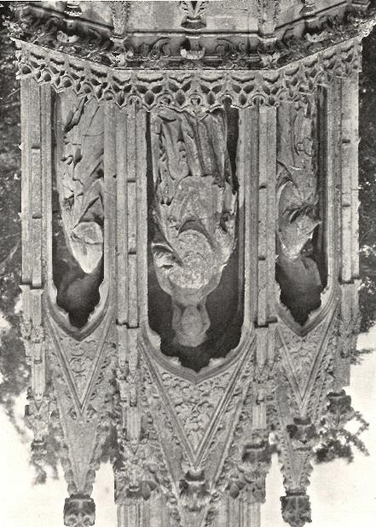
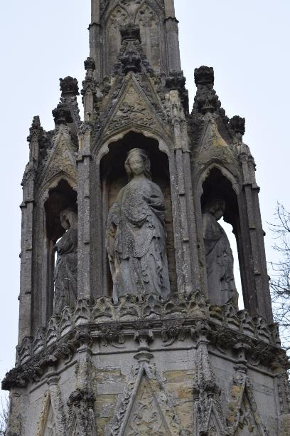
South side
Prior & Gardener - 1908
January 2019

Slide 7
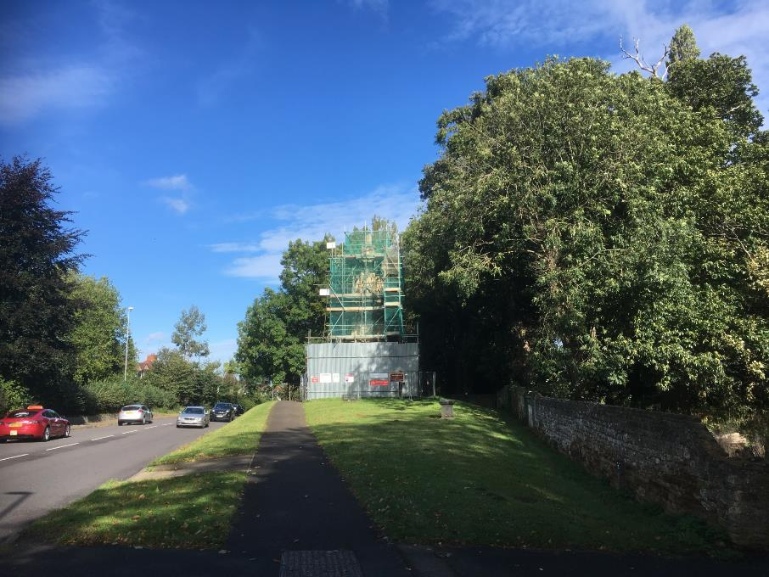

Slide 8
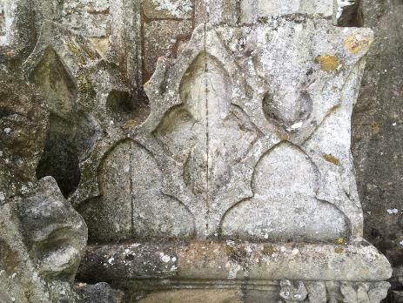
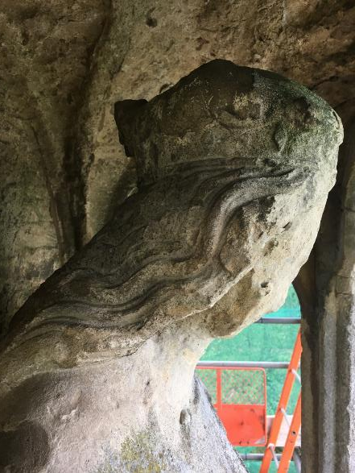
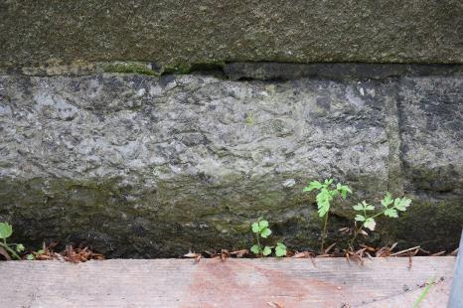
Stone types and weathering patterns

Slide 9
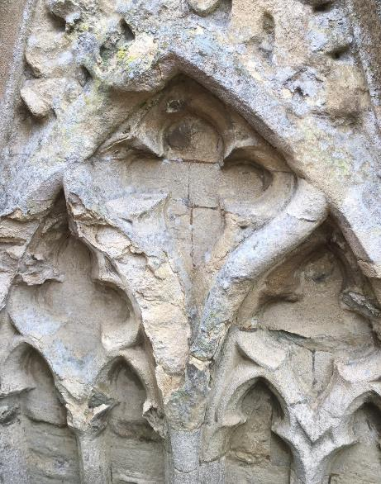
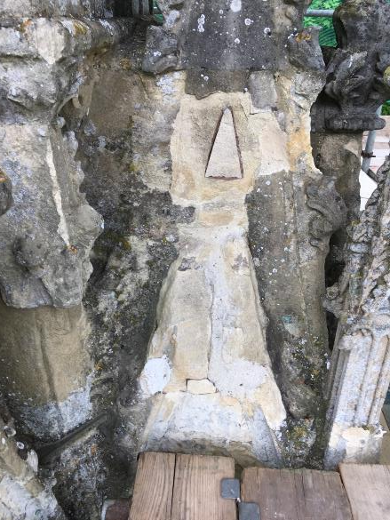
Unstable bits of stone removed during Cliveden survey exposing old repairs
Breakdown of stone surface

Slide 10
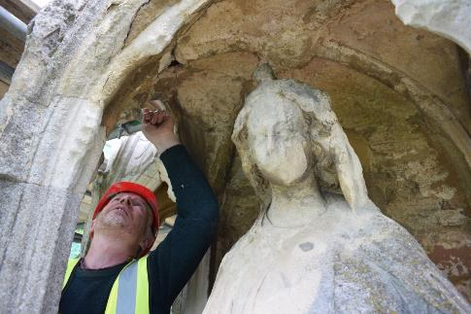
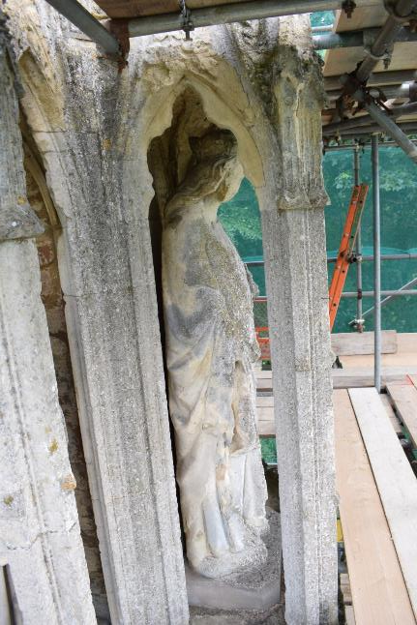
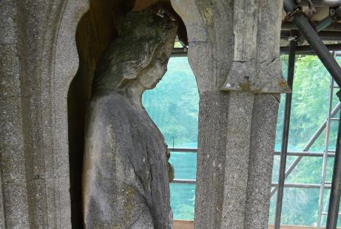
Structural problems – caused by corroding and expanding ironwork

Slide 11
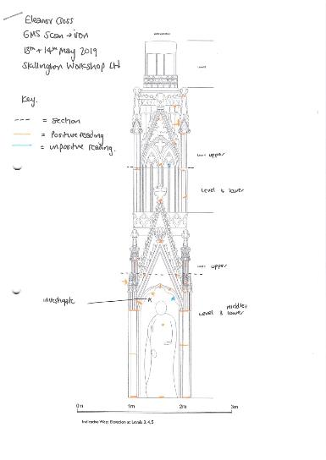
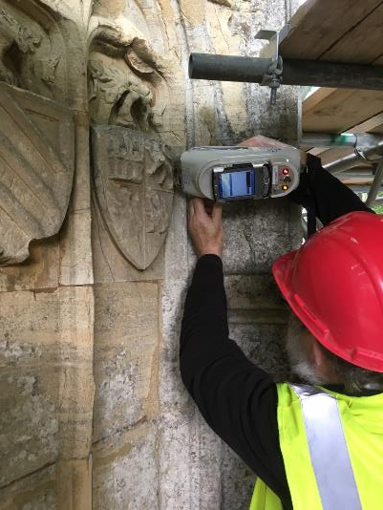
Metal detector readings
HH-XRF survey for polychromy

Slide 12
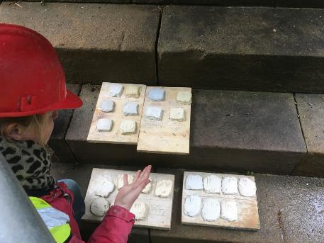
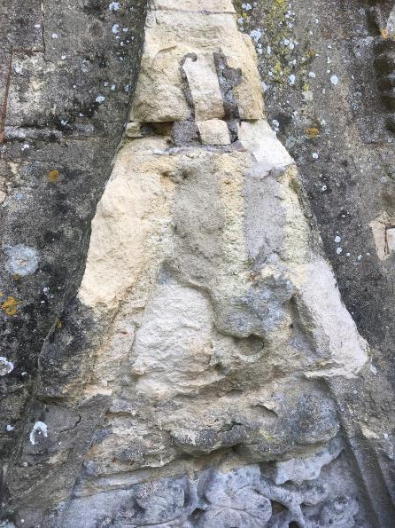
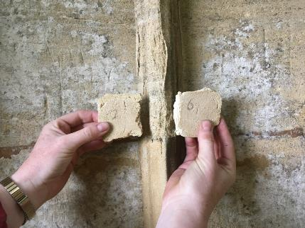
Lime mortar samples & Sheltercoat trials

Slide 13
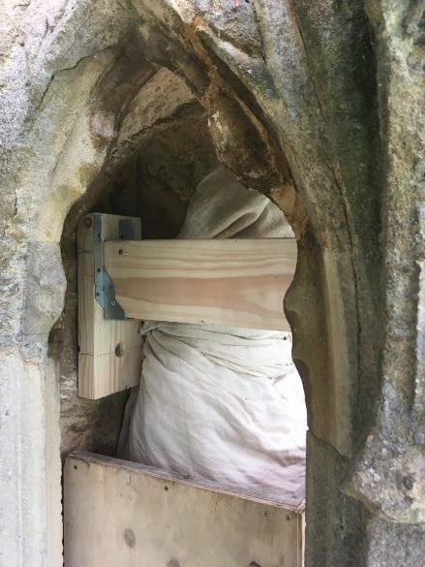
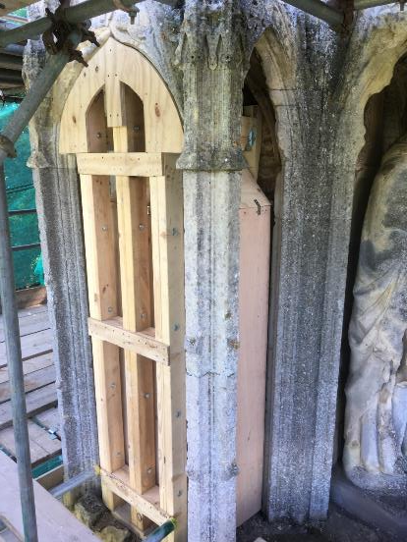
Temporary support and protection of statues

Slide 14
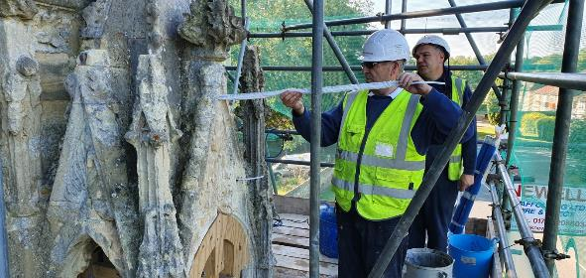
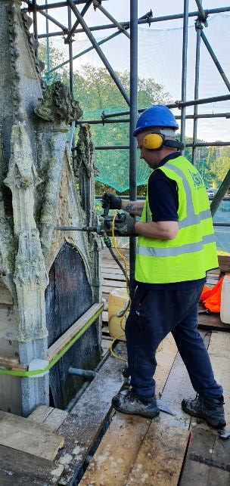
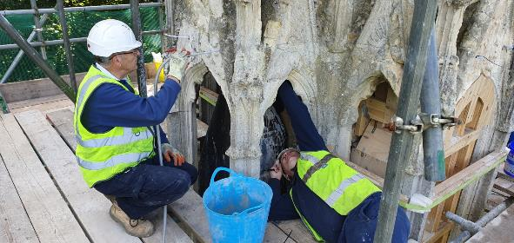
Installation of Cintec anchors

Slide 15
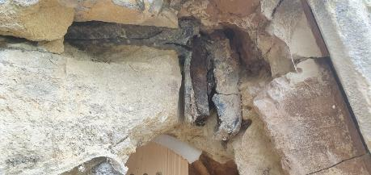
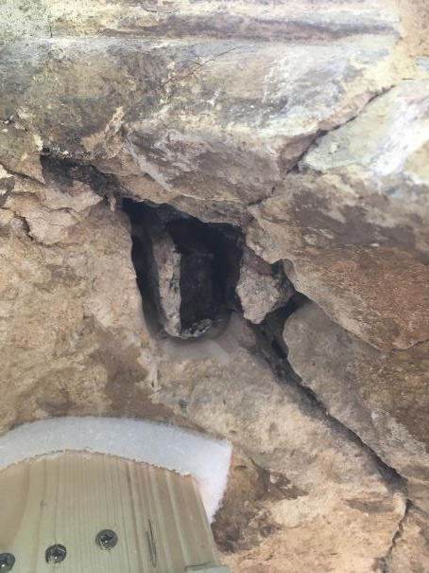
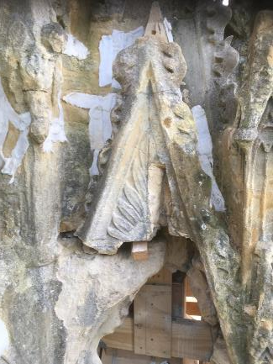

Slide 16
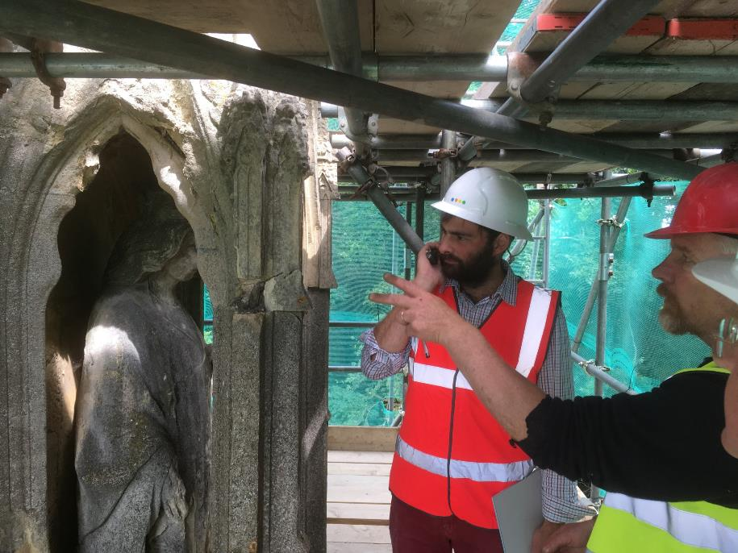

Slide 17
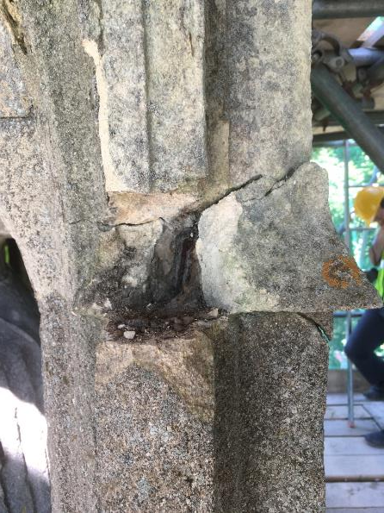
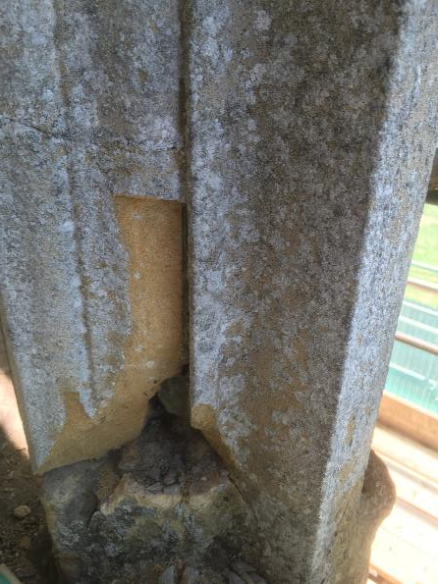

Slide 18
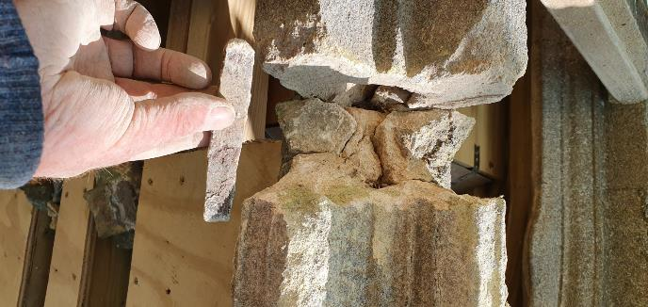
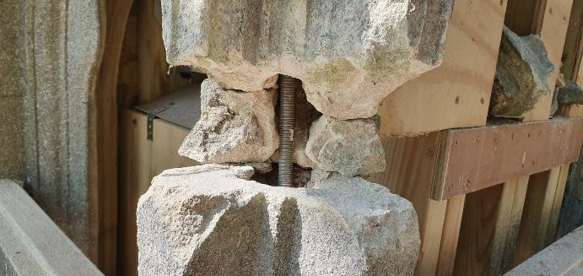

Slide 19
Lime mortar mixes
For mortar repairs:
A)
1 part Chalk lime putty
1 part sieved Baston plastering sand
1 part sieved crushed Carrstone
1 part sieved Clipsham stone dust
B)
1 part Chalk lime putty
2 parts sieved Baston plastering sand
1 part sieved crushed Carrstone

Slide 20
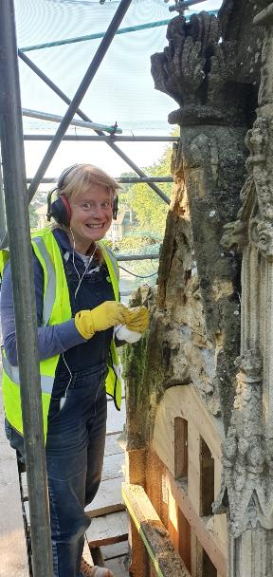
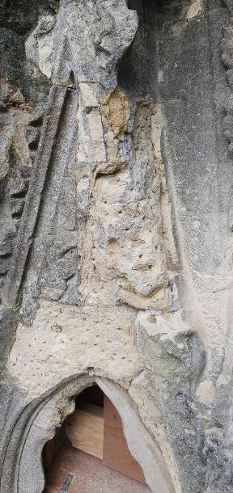
Lime work – preparation including scabbling back, making keys, grouting fissures

Slide 21
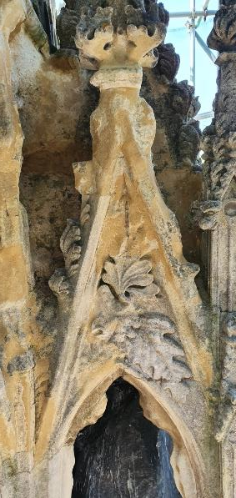
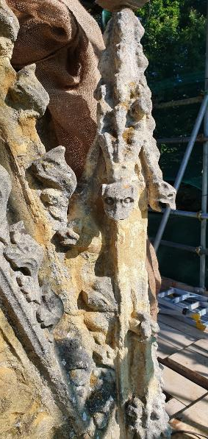
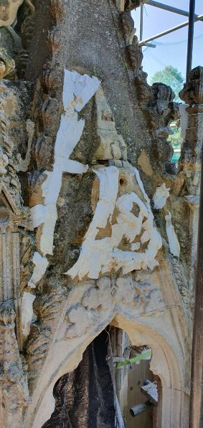
Lime work – level of repair and protection during carbonation

Slide 22
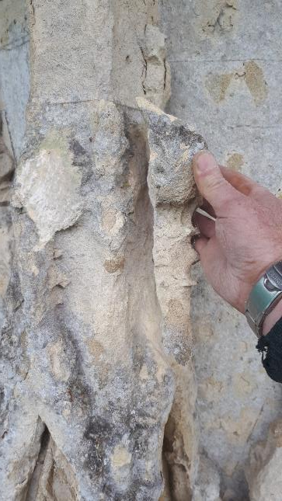
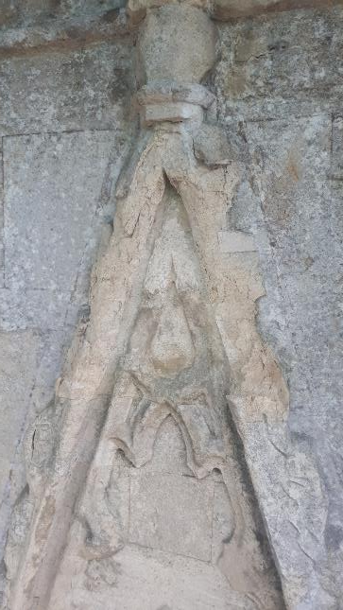
Gables below the level of the statues – condition before

Slide 23
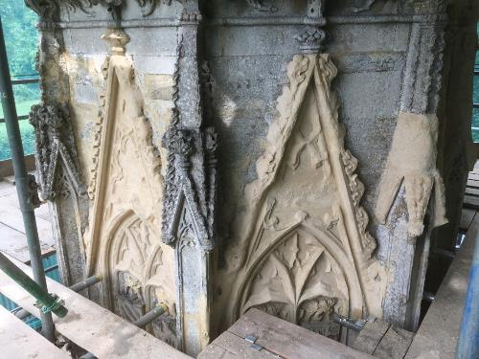
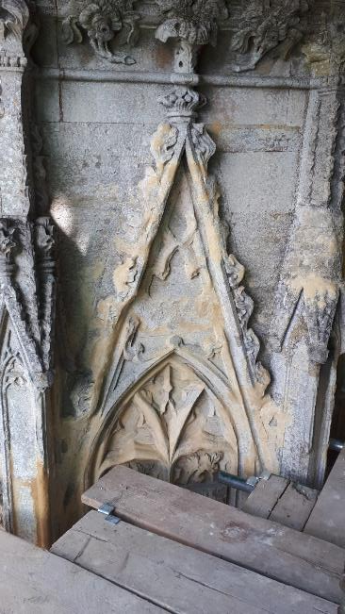
Lime work to gables on octagonal drum below the level of the statues showing mortarwork complete (left) and then sheltercoating carried out.

Slide 24
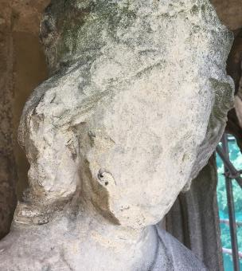
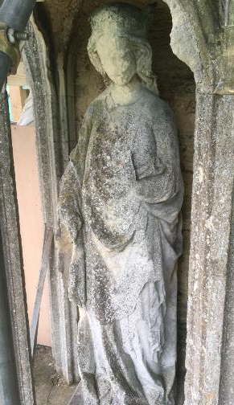
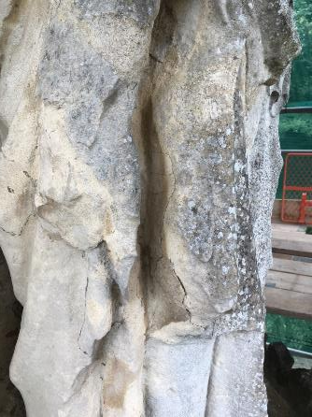
South side statue

Slide 26
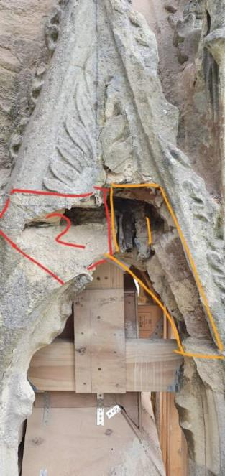
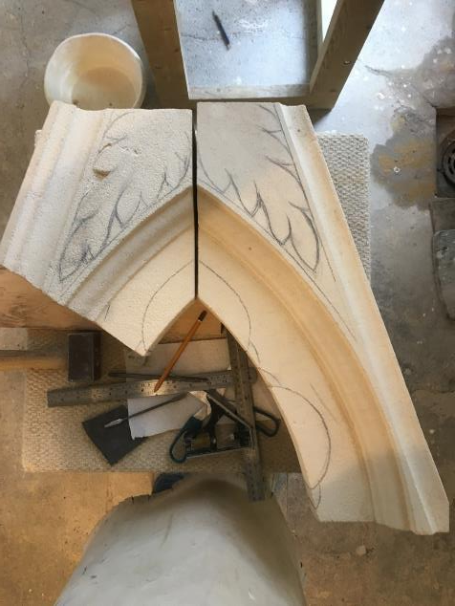

Slide 27
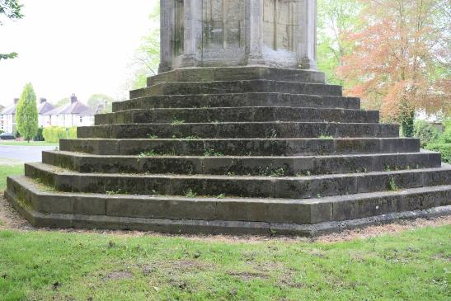
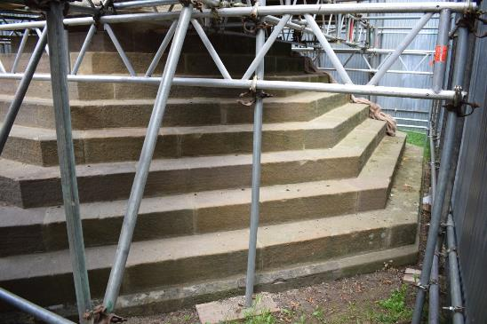
Re-pointing the steps
Mortar mix:
1 part NHL2 lime
1.5 parts Costessey sharp sand
1 part coarsely sieved crushed Carrstone
0.5 part Rottenstone

